Slide 1
Classification using deep learning neural networks for brain tumors
Vineeth Chinthakunta
700758952

Slide 2
Motivation
Importance of Brain Health: The brain's complexity and critical role in bodily functions make early and accurate detection of brain tumors essential.
Challenges in Detection: Traditional methods for brain tumor detection are often time-consuming and prone to errors.
Advancements in Technology: Deep Learning (DL) offers powerful tools for improving the accuracy and efficiency of tumor classification.

Slide 3
Problem Statement
Complexity of Brain Tumors: Differentiating between normal and various malignant brain tumors (glioblastoma, sarcoma, metastatic bronchogenic carcinoma) using MRI images.
Need for Automation: Current manual classification methods are insufficient for the required precision and speed.

Slide 4
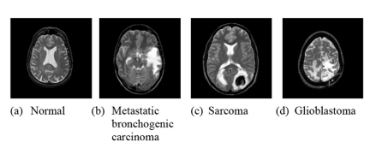

Slide 5
Objectives
Develop a Classifier: Create a deep neural network (DNN) classifier for brain tumors.
Utilize Advanced Techniques: Employ discrete wavelet transform (DWT) for feature extraction and principal component analysis (PCA) for dimensionality reduction.
Evaluate Performance: Assess the classifier's performance using various metrics.

Slide 6
Contributions
Integration of DWT and DNN: Combining discrete wavelet transform with deep neural networks for enhanced feature extraction and classification.
Performance Evaluation: Demonstrating the superior performance of the proposed method compared to other classifiers (KNN, LDA, SMO).

Slide 7
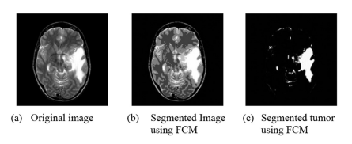

Slide 8
Results
Classification Accuracy: DNN achieved a classification rate of 96.97%.
Performance Metrics: High recall, precision, and F-measure, along with an area under the ROC curve (AUC) of 0.984.
Comparison with Other Methods: DNN outperformed KNN, LDA, and SMO in all evaluated metrics.

Slide 9
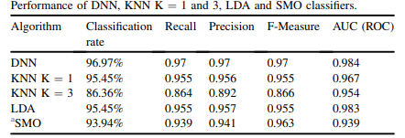

Slide 10
Critical Analysis
Strengths: High accuracy, effective feature extraction using DWT, robust performance across various metrics.
Limitations: Potential need for large datasets, computational intensity of DNN training.
Future Work: Combining DWT with convolutional neural networks (CNN) for potentially even better performance.

Slide 11
References
Primary Source: H. Mohsen et al., "Classification using deep learning neural networks for brain tumors," Future Computing and Informatics Journal, 2018.
Supporting Literature: Include relevant citations from the paper and additional sources if needed.

